Slide 1


The SPC Algorithm
Shift-based Pattern Matching for Compressed Web Traffic
Presented by Victor Zigdon^{1*}
Joint work with: Dr. Anat Bremler-Barr^{1*} and Yaron Koral²
1 Computer Science Dept. Interdisciplinary Center, Herzliya, Israel
2 Blavatnik School of Computer Sciences Tel-Aviv University, Israel
⋆ Supported by European Research Council (ERC) Starting Grant no. 259085

Slide 2


Motivation I: Compressed Web Traffic
Compressed web traffic increases in popularity
HTTP Response content encoded with gzip

Slide 3

Motivation II: DPI on Compressed Web Traffic
Handle multiple concurrent compressed sessions
Perform multi-patterns matching at line-speed
In Snort account for 70% of total execution time
Tight memory constrains (32KB per session)
Current security tools: Bypass GZIP

Slide 4
Accelerating Idea
Previous work: ACCH [infocom2009]
Compression is done by compressing repeated sequences of bytes
Store information about the pattern matching results
No need to fully perform pattern matching on repeated sequence of bytes that were already scanned for patterns ! Skipped scanning bytes !
Outcome: Decompression + pattern matching < pattern matching
The idea was implemented on Aho-Corasick Algorithm, a pattern matching algorithm which scans byte by byte
Throughput improvement: ??60%
Extra information (extra storage): 25%
4

Slide 5


Our Contribution : SPC algorithm
Apply the same accelerating idea on pattern matching algorithm that per se skipped bytes (WM - shift based algorithm)
Simpler, straightforward and more efficient algorithm
Throughput improvement: ??60%→??80%
Extra information (extra storage): 25% →12%

Slide 6
Background: GZIP Compressed HTTP
GZIP (or Deflate) are composed of two stages:
Stage 1: LZ77
Goal: Reduce text size
Technique: Compress repeating strings
Stage 2: Huffman Coding
Goal: Reduce symbol coding size
Technique: Represent frequent symbols by fewer bits

Slide 7
Background: LZ77 Compression
Compress repeated strings in the GZIP 32KB sliding window
Each repetition is represented by a pointer
Pointer == {distance, length}
ABCDEF123ABCDEF → ABCDEF123{9,6}

Slide 8
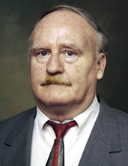

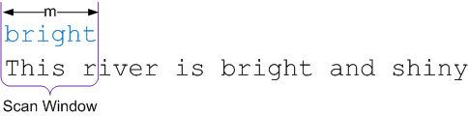

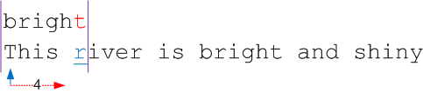
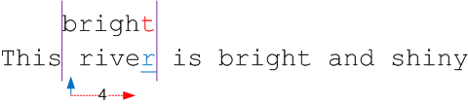
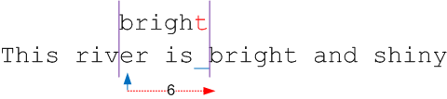
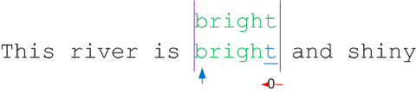
Background: The Boyer-Moore (BM) Algorithm
Shift-based single-pattern search
Main idea by example:
Shifts of size m or close to it occur most of the times, leading to a very fast algorithm
Prof. Robert Stephen Boyer
Prof. J. Strother Moore
Shift Table
otherwise | t | h | g | i | r | b | Char
6 (m) | 0 | 1 | 2 | 3 | 4 | 5 | Shift

Slide 9

Background: The Modified Wu-Manber (MWM) Algorithm
Employ BM’s shift concept to multi-pattern matching
m ≡ length of shortest pattern
Trim all patterns to their m-bytes prefix
Use m-bytes virtual ScanWindow to indicate the current position
Determine shift-value using B-bytes blocks of each pattern, rather than one byte as in BM → MaxShift = m-B+1
If the B bytes indicates a possible pattern → check if there is exact pattern.
Auxiliary data structure: PtrnsHash
Each entry holds the list of patterns with the same B-bytes prefix
We use m-bytes prefix which results in shorter lists (4.2 → 1.4)
Prof. Udi Manber

Slide 10
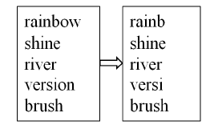
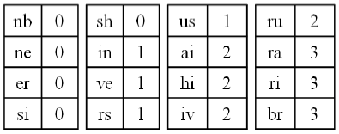















Modified Wu-Manber (MWM) Example - Simulated Scan
Patterns (m=5)
Shift Table (B=2)
Otherwise, 4 (MaxShift = 5-2+1=4)

Slide 11
Enter SPC Shift-based Pattern matching for Compressed traffic
Recall that LZ77 compress data with pointers to past occurrences of strings
→ Bytes referred by pointers were already scanned
→ If we have a prior knowledge that an area does not contain matches we can skip scanning most of it
General method:
Perform on-the-fly decompression and scanning
Scan uncompressed portions of the data using MWM and skip most of the data represented by LZ77 pointers

Slide 12
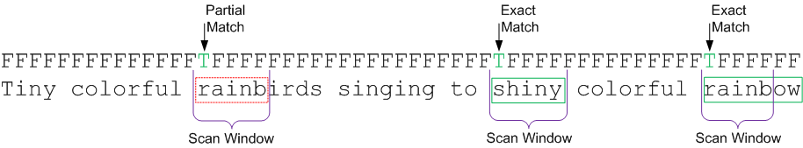
Maintaining Matches Information
partial match ≡ a match of the m-bytes scan window with the m-bytes prefix of a pattern
exact match ≡ full pattern match
PartialMatch bit-vector
Mark partial matches found in scanned text
Maintaining one bit per byte.

Slide 13
Handling Pointer Boundaries
Matches may occur in the pointer boundaries:
A prefix of the referred bytes may be a suffix of a pattern that started previous to the pointer
A suffix of the referred bytes may be a prefix of a pattern that continues after the pointer
→Special care needs to be taken to handle pointer boundaries and maintain MWM characteristics
1
2
1
2
1
2

Slide 14
SPC = MWM + Pointers
While scanning text, update the PartialMatch bit-vector
As long as scan window is not fully contained within a pointer boundaries, perform regular MWM scan
This handles, pointer boundary case
When the m-bytes scan window shifts fully into a pointer, check which areas of the pointer can be skipped
This is performed by addressing the PartialMatch bit-vector
Continue regular MWM scan at m-1 bytes before the end of the pointer
This handles, pointer boundary case
1
2

Slide 15
Scanning and Skipping Pointers
If no partial matches are found in the pointer
Safely shift the scan window to m-1 bytes before the pointer end
Effectively skipping the internal body of the pointer
For each partial match marked in the referred area
Mark this position as a partial match in the pointer
Check for exact match against this text position

Slide 16
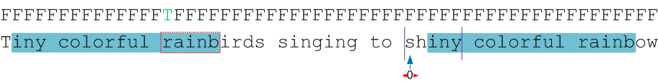
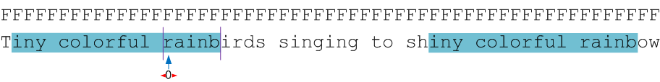
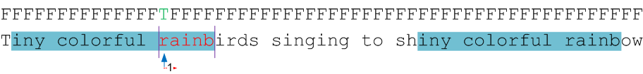
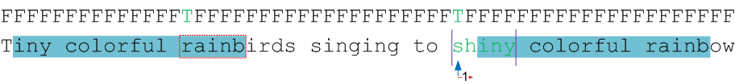
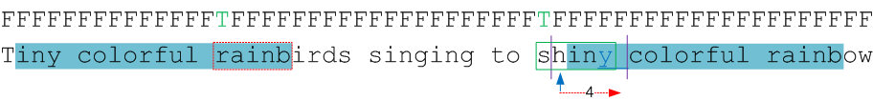
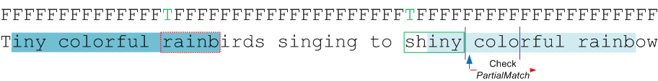
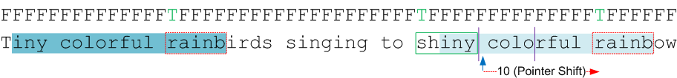
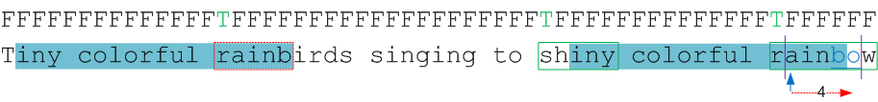
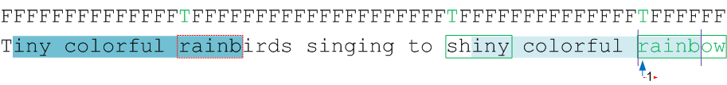
SPC Simulated Scan Example
Patterns (m=5)
Shift Table (B=2)
Otherwise, 4 (MaxShift = 5-2+1=4)

Slide 17
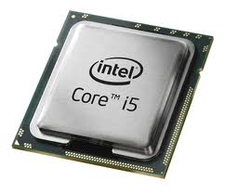


The Setup
The Platform
Intel Core i5 750 processor, with 4 cores
The Data-Set
6781 HTTP pages encoded with GZIP (Alexa.org top sites)
335MB in an uncompressed form (or 66MB compressed)
92.1% represented by pointers
16.7bytes average pointer length
The Pattern-Set
Snort (NIDS), total of 10621 patterns
6837 text patterns (results in 11M matches, 3.24% of text)
Also in the paper Mod security rules

Slide 18
SPC Characteristics Analysis
Skip ratio definition = percentage of characters the algorithm skips
SPC shift ratio is based on two factors:
MWM shift for scans outside pointers
Skipping internal pointer byte scans
For m = B: MWM does not skip at all
SPC shifts are based solely on pointer skipping (ranges from 60% to 70%)

Slide 19
SPC Run-time Performance Multi-core Throughput
SPC’s throughput on our platform
For Snort, 1.016 Gbit/sec for m=5 and B=4
For ModSecurity, 2.458 Gbit/sec for m=5 and B=3
Those results were received by running with 4 threads that performs pattern matching on data loaded in advance to the main memory
The algorithms were implemented in C# using general purpose libraries
Better throughput could be achieved by using optimized software libraries or hardware optimized for networking

Slide 20
SPC Run-time Performance Throughput Normalized to ACCH
m=6 gains the best performance
However, we choose m=5 as a tradeoff between performance and pattern-set coverage
SPC’s throughput is better than that of ACCH
For m = 5, on Snort, we get a throughput improvement of 51.86%,
SPC is faster than MWM’s for all m and B values
For Snort, the throughput improvement is 73.23%

Slide 21
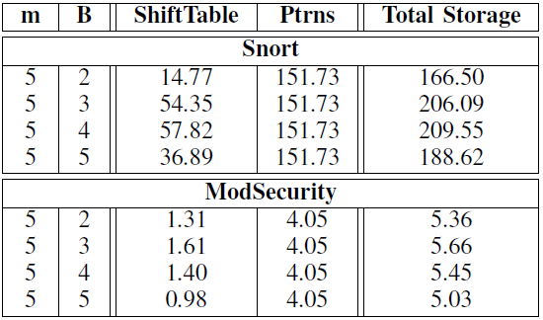
SPC Storage Requirements
Our MWM and SPC requires only 1.88 bytes per char
High probability to reside within the cache
Original MWM requires 1.4KB per char

Slide 22
Conclusion
HTTP compression gains popularity
High processing requirements ➔ ignored by FWs
SPC accelerates the entire pattern matching process
Taking advantage of the information within the compressed traffic
Compared to ACCH
SPC Gains a performance boost of over 51%
SPC use half the space (4KB) of the additional information needed per connection
SPC is simpler, straightforward and more efficient
Encourage vendors to support inspection of compressed traffic

Slide 23

Questions?

